Slide 1
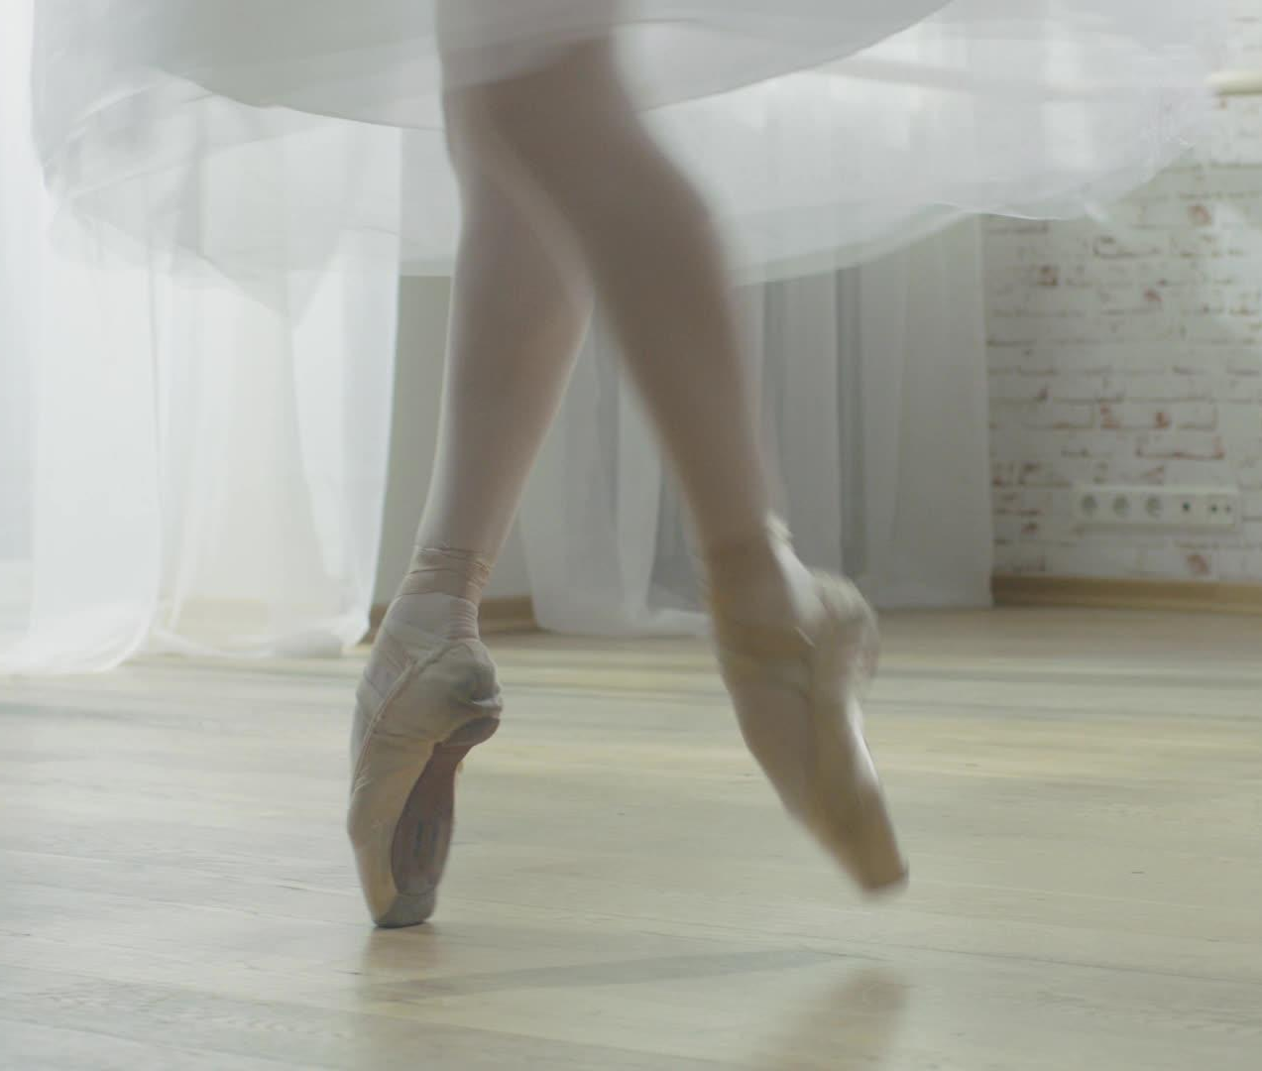
Extra-curricular Dance at BGHS 2024

Slide 2
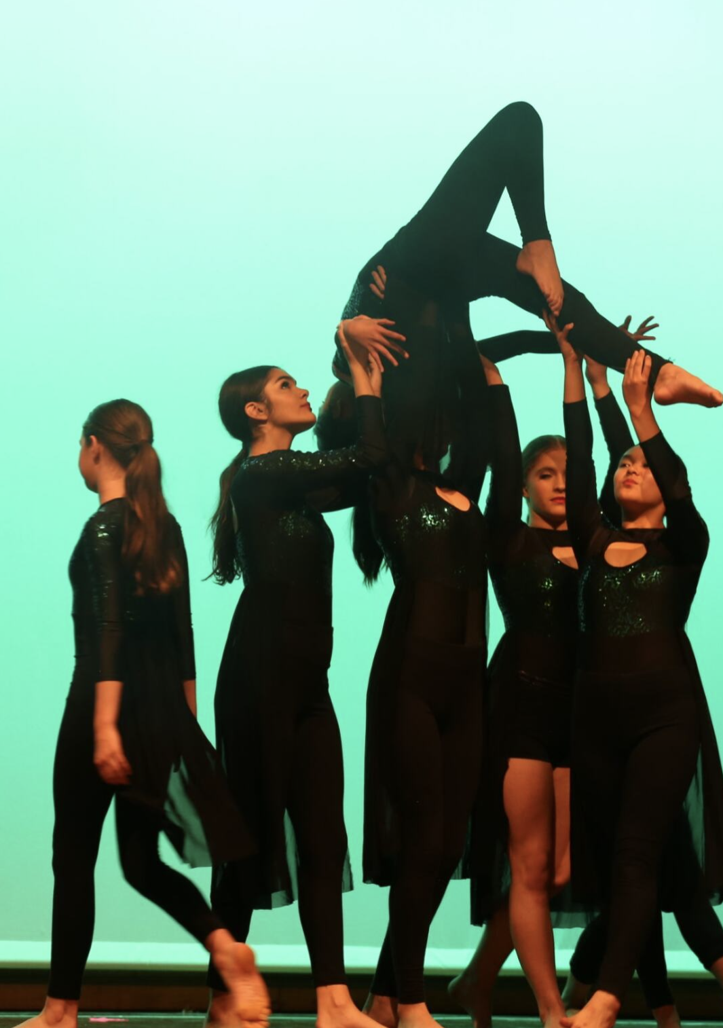
What styles can you do?
Beginner/Intermediate Ballet (Years 7-12)- Mondays 7:30-8:30am
Acrobatics (Years 7-12)- Mondays Lunch
Junior Contemporary Company (Years 7 - 9) - Mondays 3:25 - 4.25pm
Strength and Conditioning Tuesdays 7:45-8:30am

Slide 3
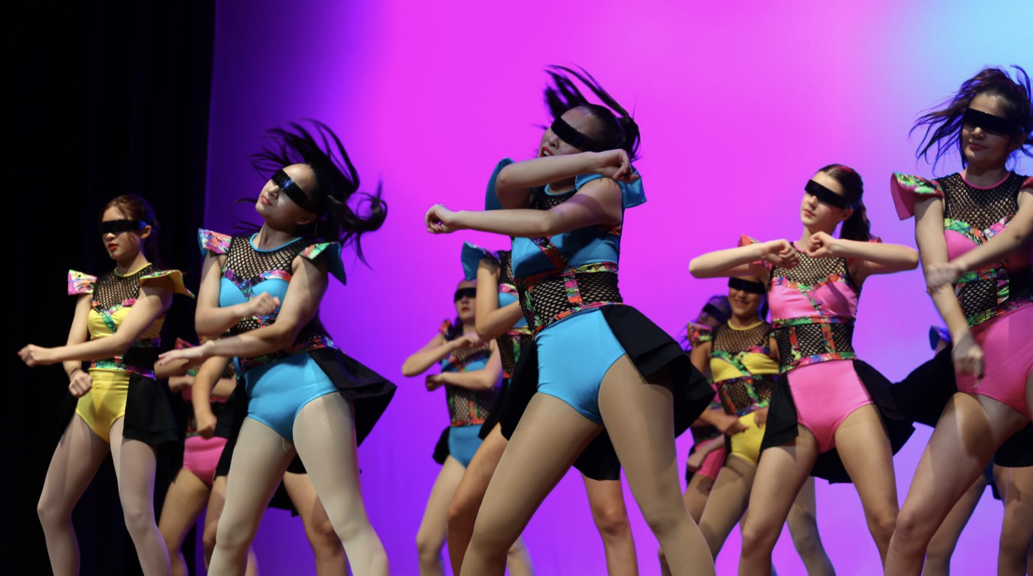
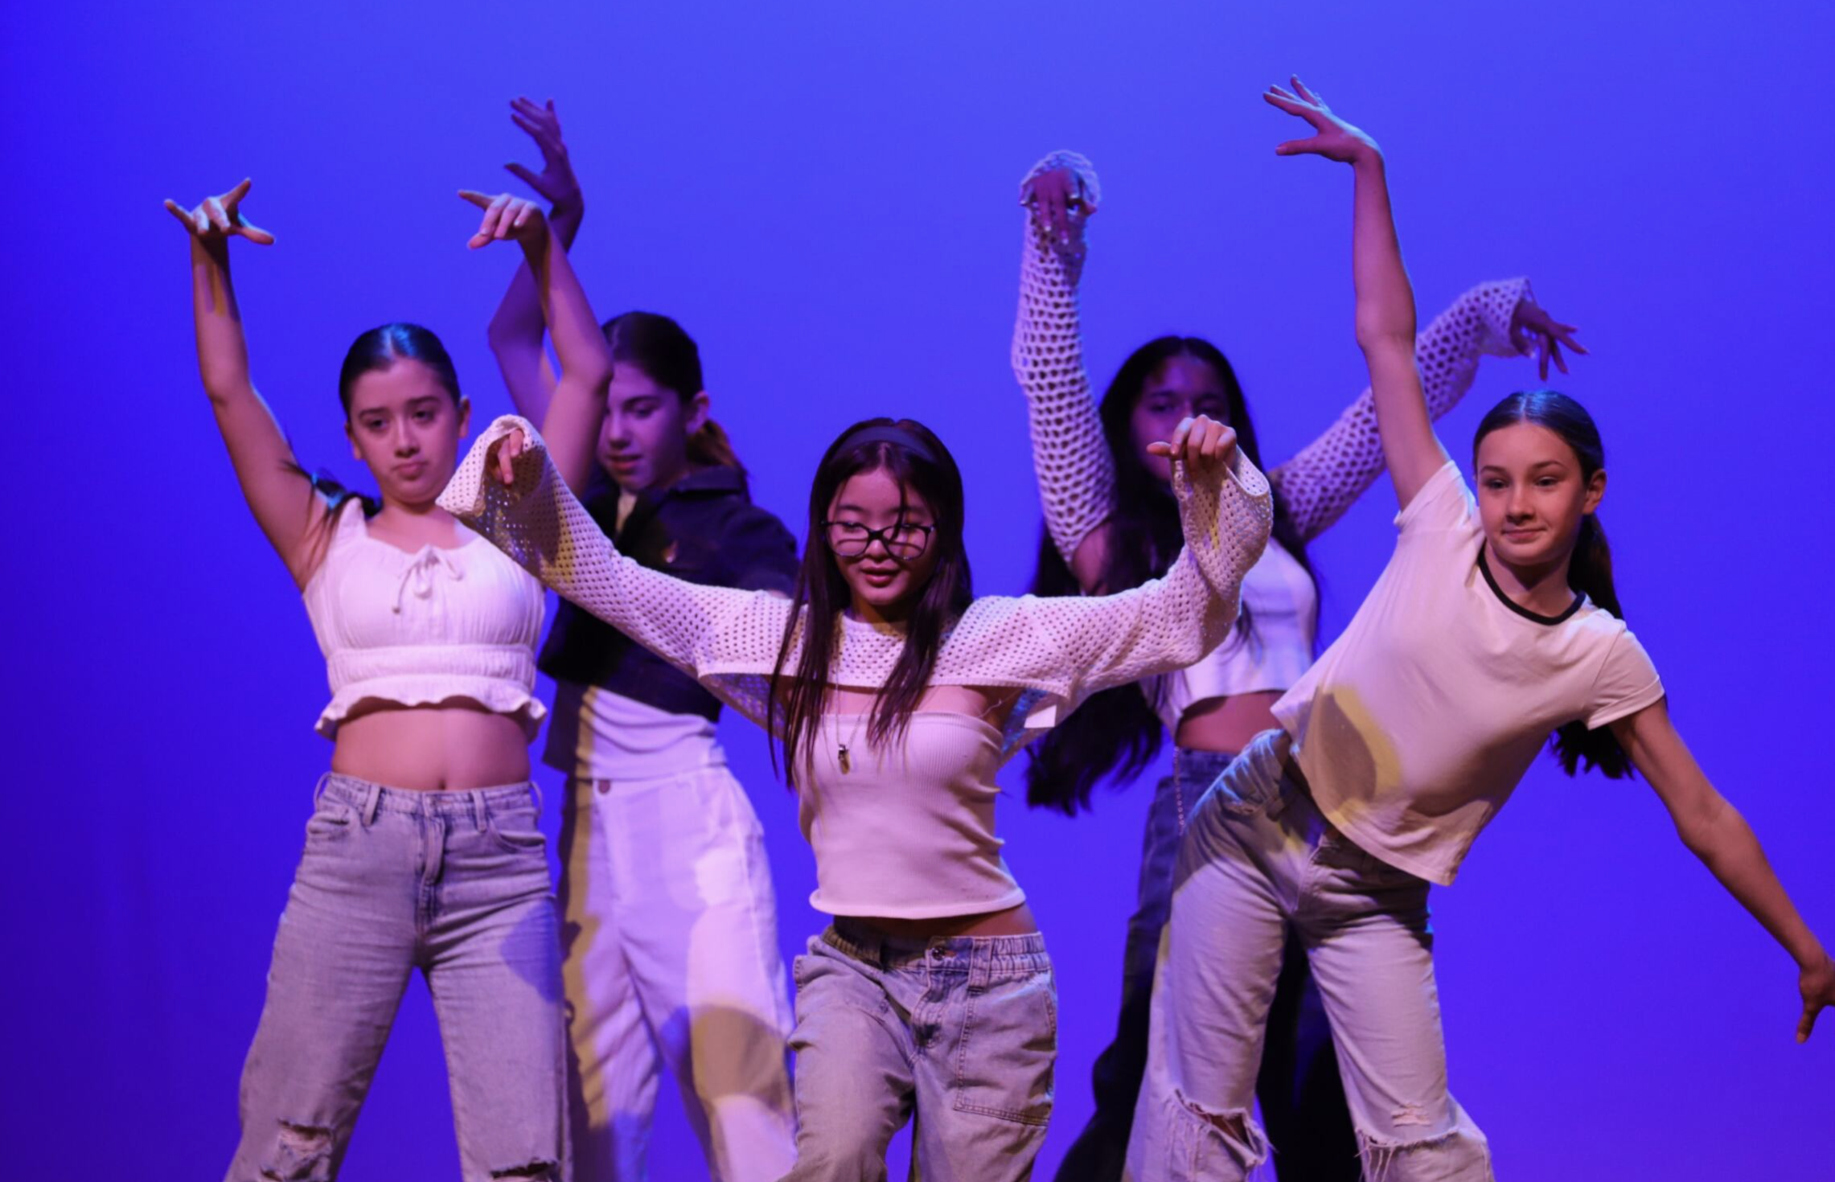
What styles can you do?
Dance Ensemble (Years 8-11) - Tuesday Sport time
K-Pop (Year 8-11) - Tuesday Sport Time
Bollywood! (Year 8-11) - Tuesday Sport Time
Hip Hop - Thursdays Lunch
Jazz - Thursdays 3.25 - 4.25pm

Slide 4
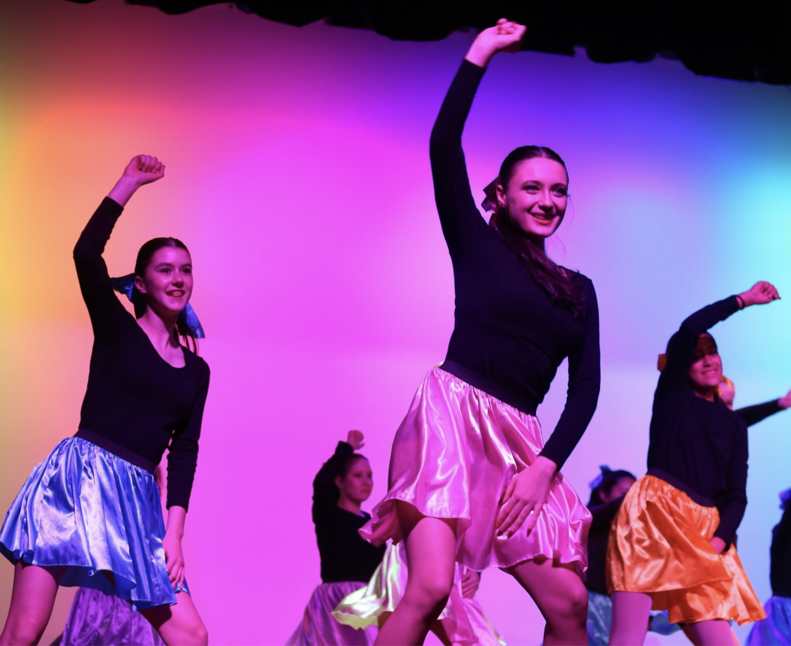
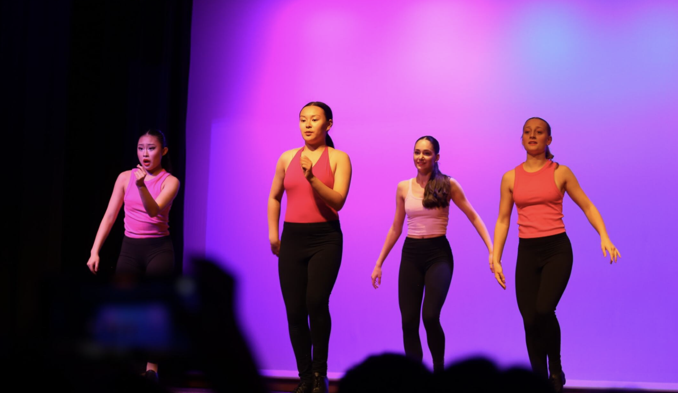
What styles can you do?
Musical Theatre (Years 7-12) Wednesdays 3.20-4.20pm
Tap (Years 7-12)- Intermediate Level - Wednesdays Lunch

Slide 5
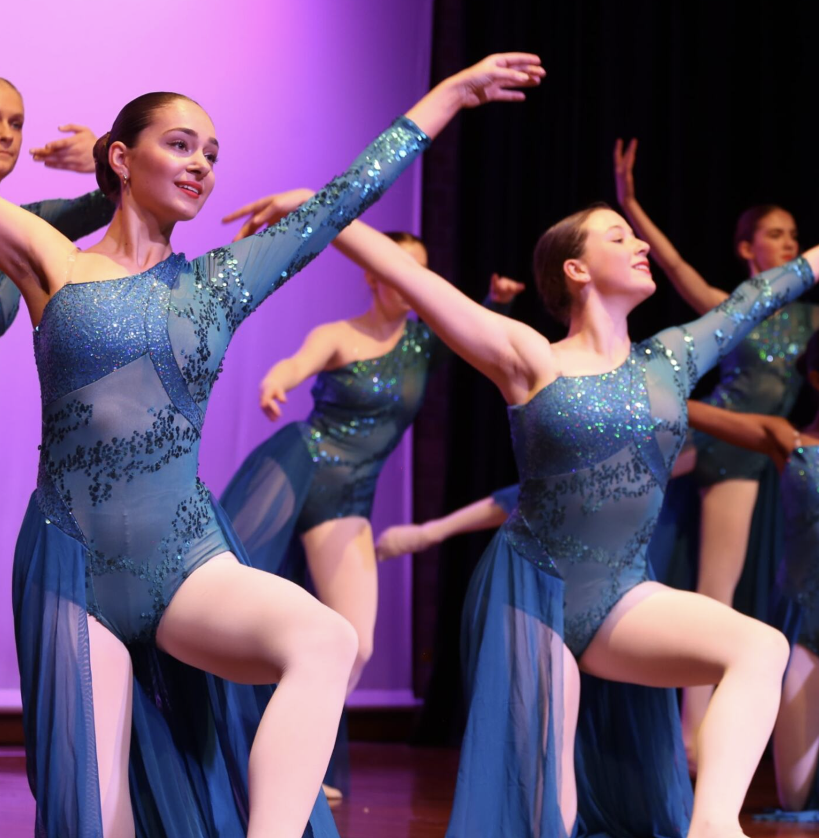
What styles can you do?
Advanced Ballet - Wednesdays 7:30-8:30am
Senior Contemporary (Years 10-12) - Fridays 7:30-8:30am

Slide 6
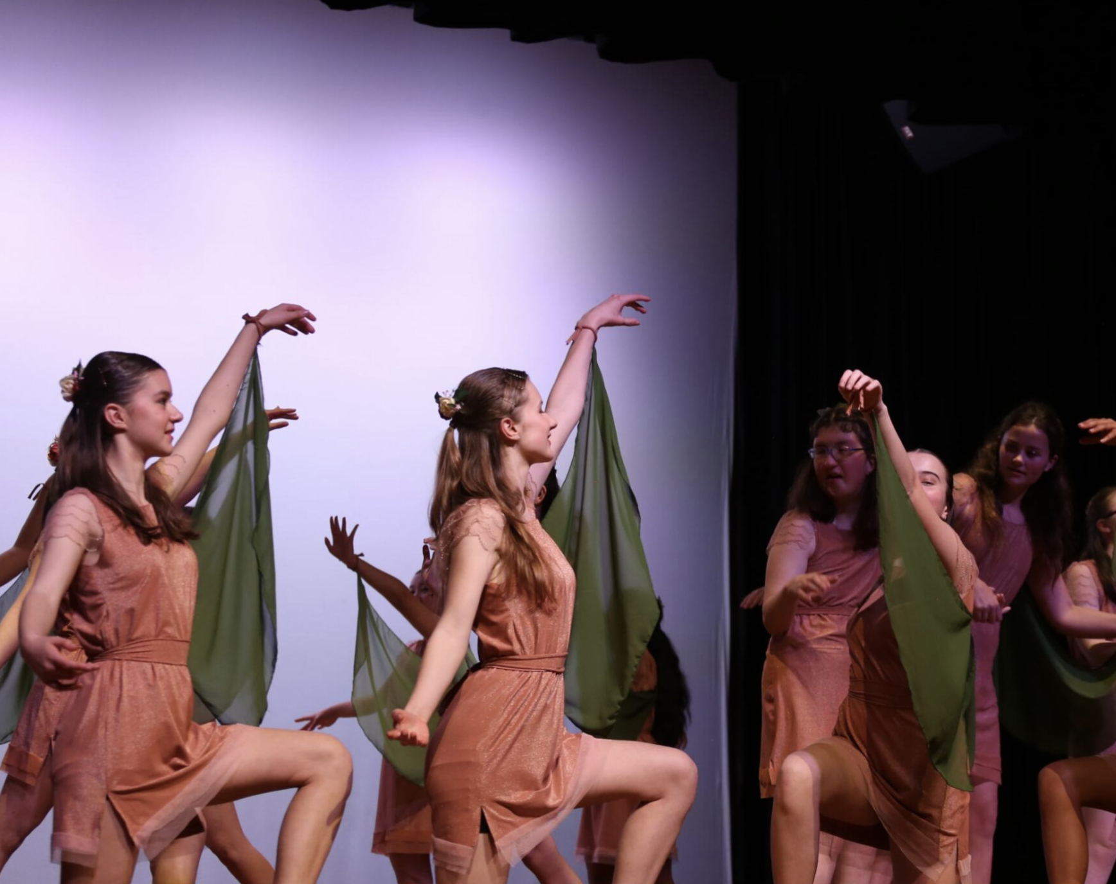
What styles can you do?
Inclusive Ensemble for students with and without disability!
Friday lunch times. No audition required :)

Slide 7
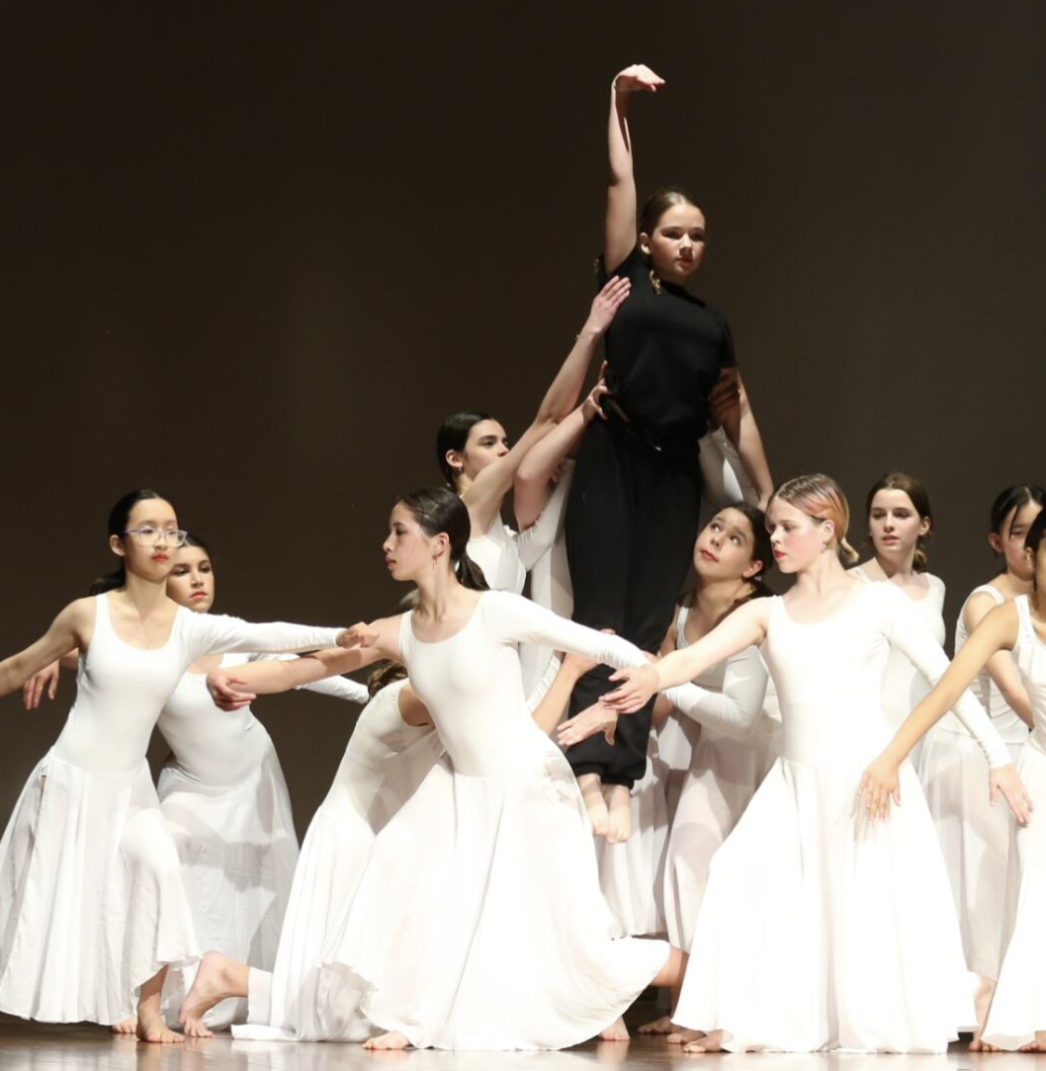
What styles can you do?
Year 7 Only! Wednesday OR Thursday Lunchtimes. No audition required, days to be confirmed. Starts week 7.

Slide 8
Year 7 ONLY
Year 7 dance ensemble is no audition and is exclusive to Year 7 students only. These Year 7 students will work closely with Year 11 Elective Dance students on a performance for Showcase.
It only costs $60.00 a year.
Rehearsals are during one lunch time a week and will start in Week 7, Term 1, so you have time to settle in to school before deciding if you want to join.
Year 7 students unfortunately cannot audition for K-Pop or Dance Ensemble as they run during Sport on Tuesday afternoons.

Slide 9
What else do you need to know??
YOU MAY AUDITION FOR AS MANY ENSEMBLES AS YOU LIKE AND BE A PART OF AS MANY ENSEMBLES AS YOU LIKE, AS LONG AS THEY ARE NOT RUNNING AT THE SAME TIME.
EACH ENSEMBLE ONLY COSTS $300.00 PER YEAR - MUCH CHEAPER THAN DANCE STUDIO FEES! (LESS THAN $8 PER CLASS!).
INCLUSIVE DANCE- NO AUDITION, $150 PER YEAR. STRENGTH AND CONDITIONING- $225
WE EMPLOY EXTREMELY TALENTED AND PROFESSIONAL EXTERNAL TUTORS FOR ALL ENSEMBLES.
THERE ARE MANY DIFFERENT PERFORMANCE OPPORTUNITIES THROUGHOUT THE YEAR, NOT JUST AT SCHOOL.
SEE ME IN THE PDHPE STAFFROOM IF YOU HAVE ANY QUESTIONS- MS LEE, MRS JAMIESON and MS CREDLIN are our current dance teachers here :)

Slide 10
Audition Times
Beginner Ballet- Monday- Week 3: 12th February 2024- 7:30-8:30am in Movement Studio
Acrobatics- Monday- Week 3: 12th February 2024- Lunch in the Fitness Lab
Junior Contemporary Company - Monday - Week 3: 12th February 2024 - 3:30-4:30pm in Movement Studio
Dance Ensemble - Monday- Week 2: 5th February 2024- Lunch time in Movement Studio
K-Pop - Monday - Week 2- 5th February 2024– Lunch time in Fitness Lab
Bollywood- Monday- Week 2- 5th February 2024- Lunch in the hall
Advanced Ballet Ensemble - Wednesday - Week 3: 14th February 2024 - 7:30-8:30am in Movement Studio
Tap Ensemble - Wednesday - Week 3: 14th February 2024 - Lunch in HALL
Musical Theatre - Wednesday - Week 3: 14th February 2024 - 3:20-4:20pm in Movement Studio
Hip Hop- Thursday - Week 3 & 4: 15th February 2024 - Lunch in Fitness Lab
Jazz- Thursday - Week 3 & 4: 15th February 2024 - 3:25-4:25pm in Movement Studio
Year 7 Dances Ensembles - Wednesday or Thursday, starting in Week 7, 2024 (NO audition required)
Senior Contemporary Company - Friday- Week 3: 16th February 2024 - 7:30-8:30am in Movement Studio
Inclusive Ensemble - Friday - Week 3: 16th February 2024-- 1:10-2:00pm in Movement Studio (NO audition required)

Slide 11
How do I sign up for audition?
If you wish to audition for a Dance Ensemble in 2024, there will be a Google Form to complete and the link will be on the BGHS Dance Google Classroom and on Sentral.
Once you attend an audition, you will be given an information note to take home for your parent/guardian to look through and for you both to understand the expectations of being a part of an ensemble.
YEAR 7 OR NEW STUDENTS - Paper copies of the sign up forms will be available to collect from the PDHPE staffroom if you do not have access to the internet.
If you have any trouble signing up, or you have any questions, please see Ms Lee in the PDHPE Staffroom.
THANK YOU!

